Slide 1

National University of Computer and Emerging Sciences
Generative Adversarial Networks
AI-4009 Generative AI
Dr. Akhtar Jamil
Department of Computer Science

Slide 2
Generative Adversarial Network (GAN)
Generative Adversarial Networks (GANs) were introduced in 2014 by Ian J. Goodfellow and co-authors.
GANs perform unsupervised learning tasks in machine learning.
It consists of 2 models that automatically discover and learn the patterns in input data.
Generator and Discriminator.
Can be used in generating images, videos, text.

Slide 3
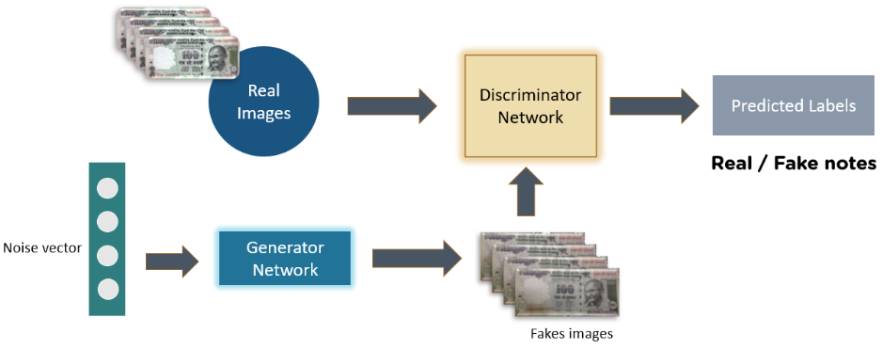
Generative Adversarial Network (GAN)

Slide 4
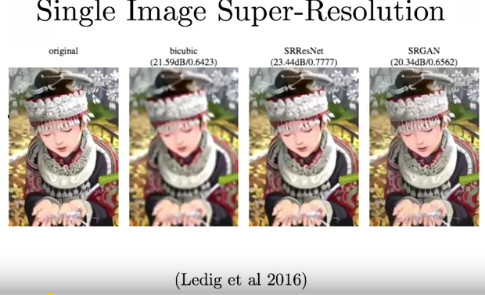
Generative Adversarial Network (GAN)

Slide 5
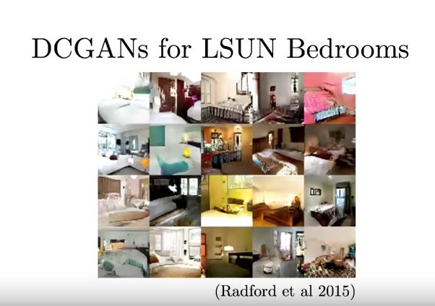

Slide 6
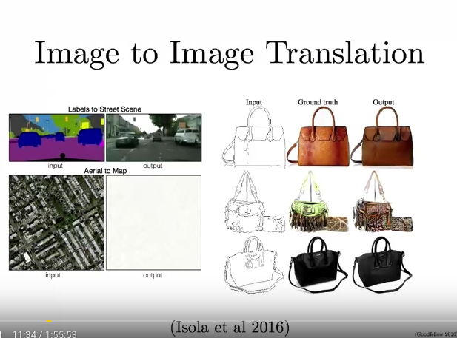

Slide 7
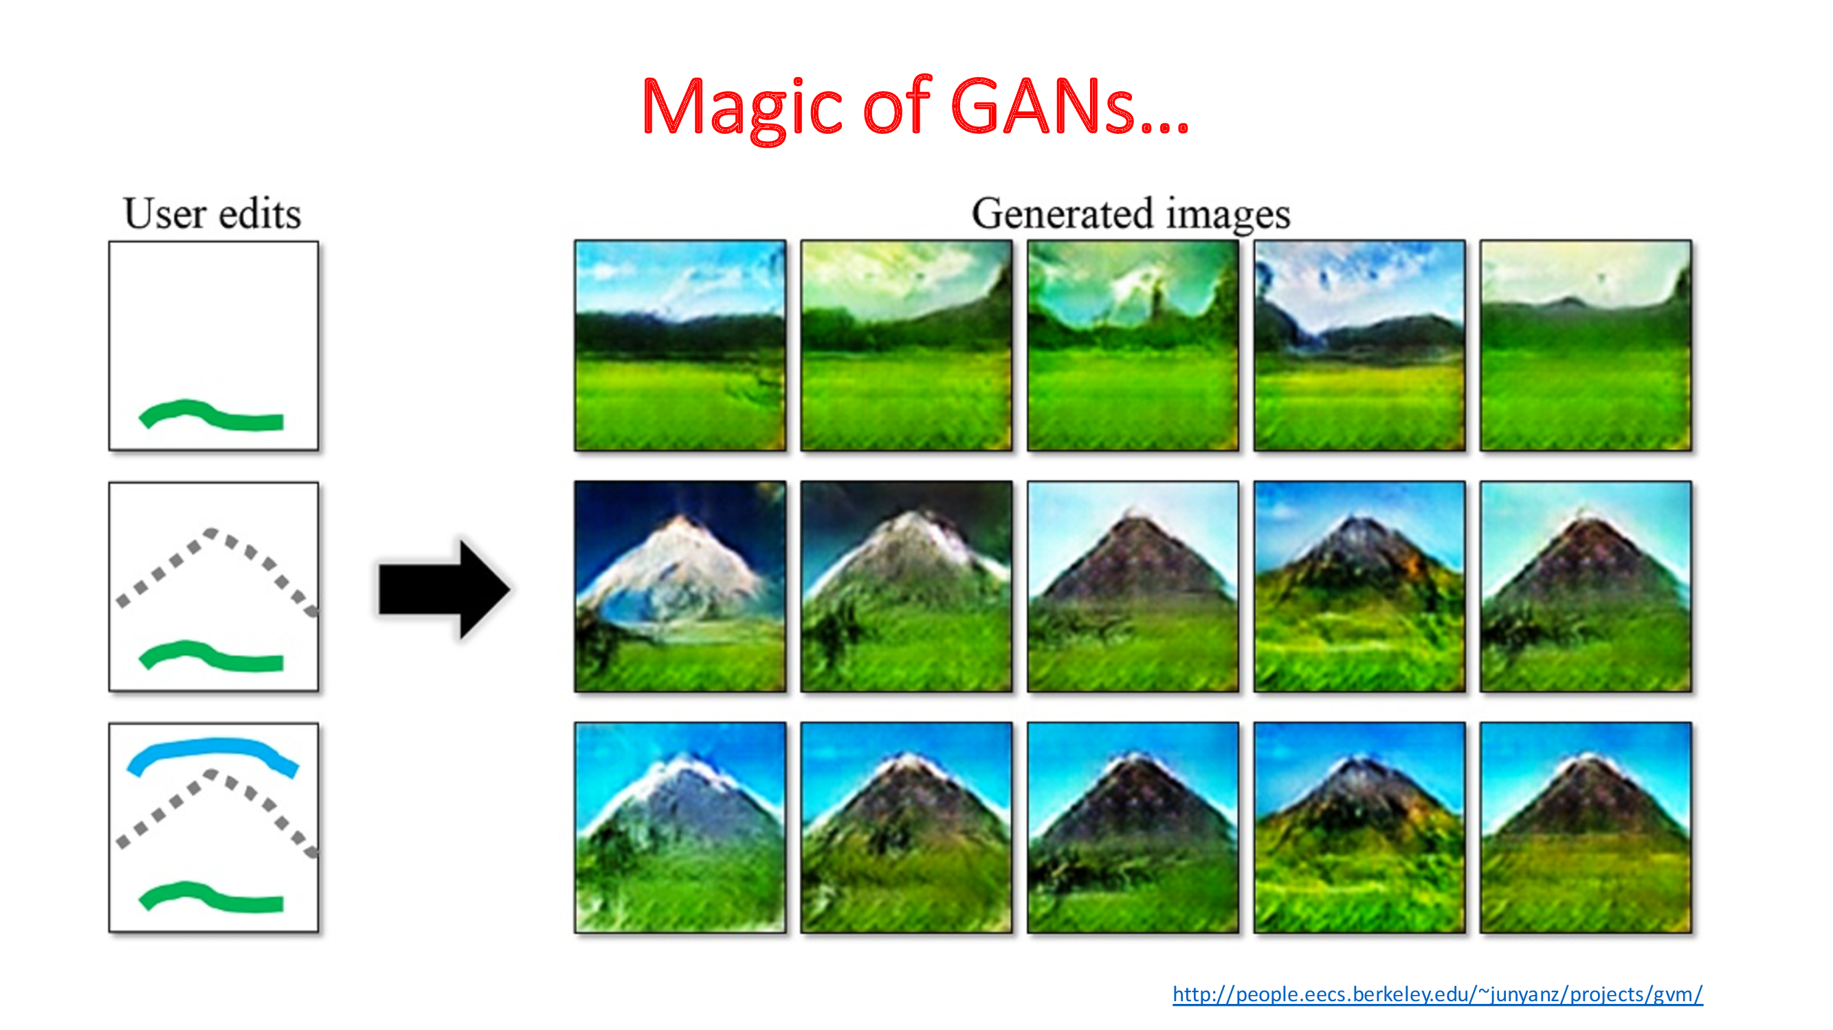

Slide 8
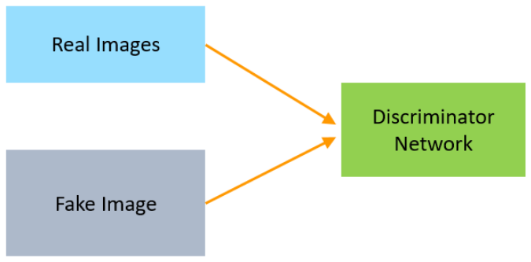
Generative Adversarial Network
Generator vs Discriminator
They compete with each other to capture, and replicate the variations within a dataset.

Slide 9
Generative Adversarial Network
Generator:
A Generator in GANs is a neural network that creates fake data to be trained on the discriminator.
It learns to generate probable data.
The generated examples/instances become negative training examples for the discriminator.
It takes a fixed-length random vector carrying noise as input and generates a sample.

Slide 10
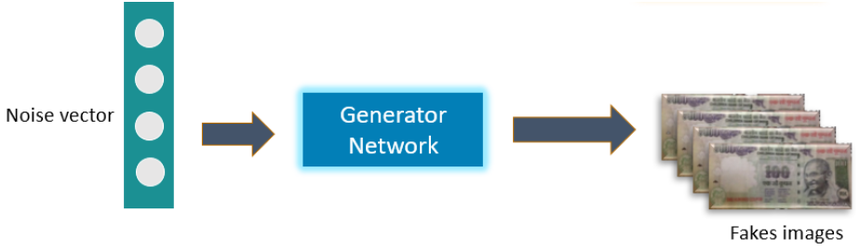
Generative Adversarial Network
The main aim of the Generator is to make the discriminator classify its output as real.
This can happen when the generator generates realistic images.

Slide 11
Generative Adversarial Network
Discriminator
The Discriminator is a neural network that identifies real data from the fake data created by the Generator.
The discriminator's training data comes from two different sources:
The real data instances
The fake data instances

Slide 12

Generative Adversarial Network
Complete GAN Network

Slide 13
Random Input
In its most basic form, a GAN takes random noise as its input.
The generator then transforms this noise into a meaningful output.
By introducing noise, we can get the GAN to produce a wide variety of data.
What choices?
Gaussian (Normal) Distribution:
Sample values from a normal distribution with a mean of 0 and a standard deviation of 1 (i.e., 𝑁(0,1)N(0,1)).
Uniform Distribution: The values can be sampled uniformly from a fixed range, e.g. -1 and 1 or 0 and 1.

Slide 14
GAN Training
Because a GAN contains two separately trained networks, its training algorithm must address two complications:
GANs must switch two different kinds of training (generator and discriminator).
GAN convergence is hard to identify.
Alternating Training
The discriminator trains for one or more epochs.
The generator trains for one or more epochs.
Repeat steps 1 and 2 to continue to train the generator and discriminator networks.

Slide 15
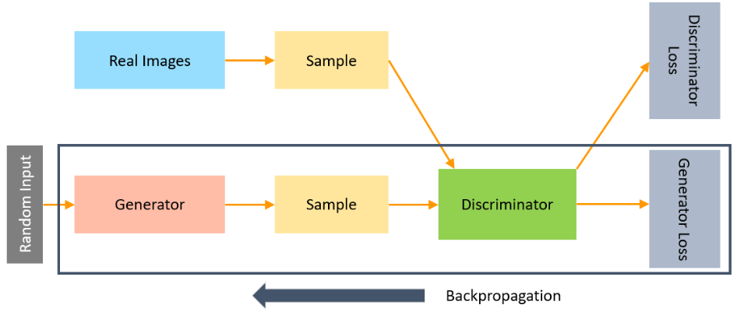
Generative Adversarial Network
The backpropagation method is used to adjust each weight in the right direction by calculating the weight's impact on the output.

Slide 16
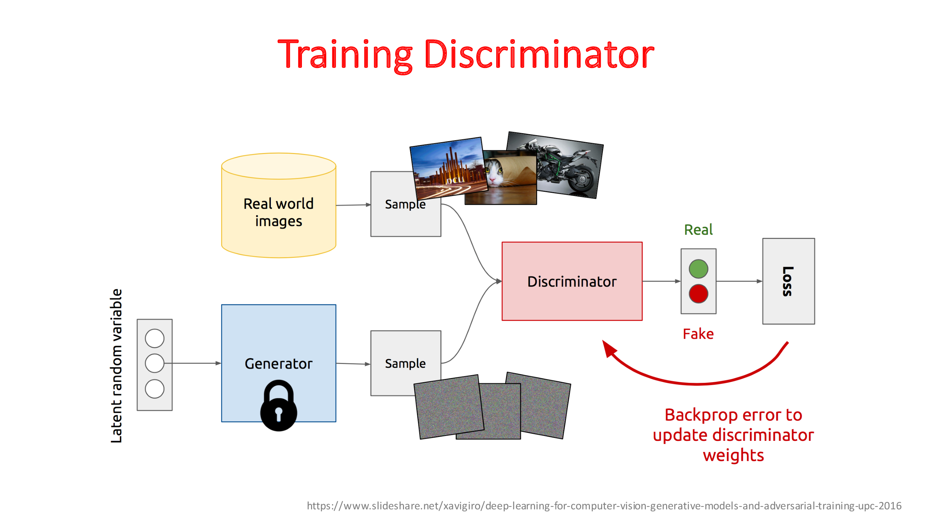

Slide 17
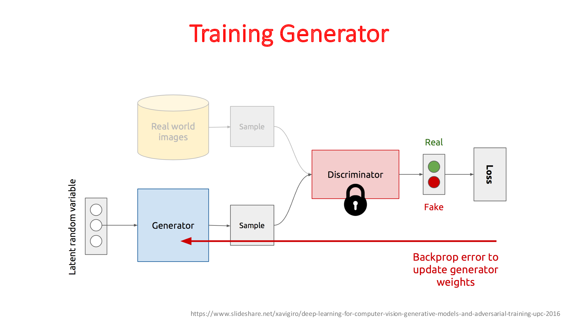

Slide 18
Generative Adversarial Network
Loss Functions
GANs generate the probability distribution of a particular data.
Loss functions measures distance between the distribution of the data generated by the GAN and the distribution of the real data.
Active research area
Many approaches have been proposed.
GANs have two loss functions: one for generator training and one for discriminator training.
Two common GAN loss functions:
Minimax loss
Wasserstein loss

Slide 19
Loss Functions
Minimax Loss

Slide 20

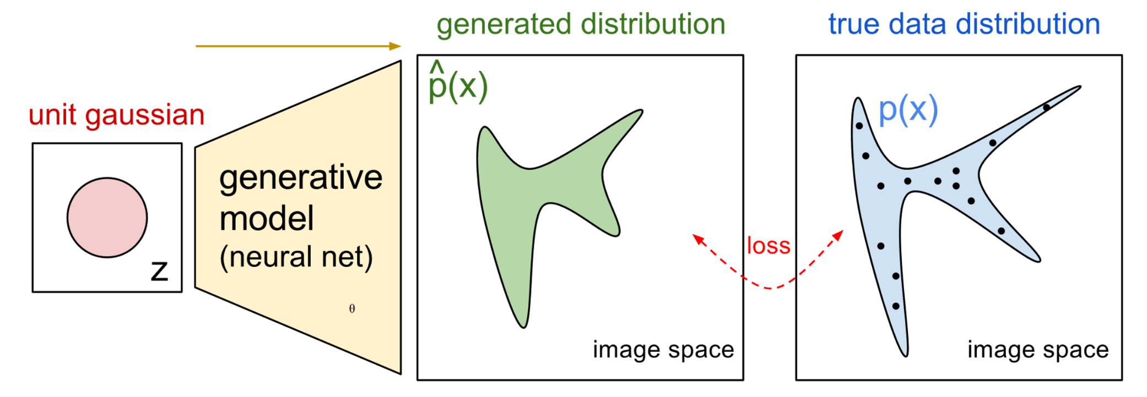

NN for P_{G}(x; θ)
P_{G}(x,θ)
P_{data}(x)
G
θ
Prior
distribution
of z
Smaller
dimension
Larger
dimension
How to compute the likelihood?
P_{G}(x) = Integration_{z} P_{prior}(z) I_{[G(z)=x]}dz
https://blog.openai.com/generative-models/

Slide 21
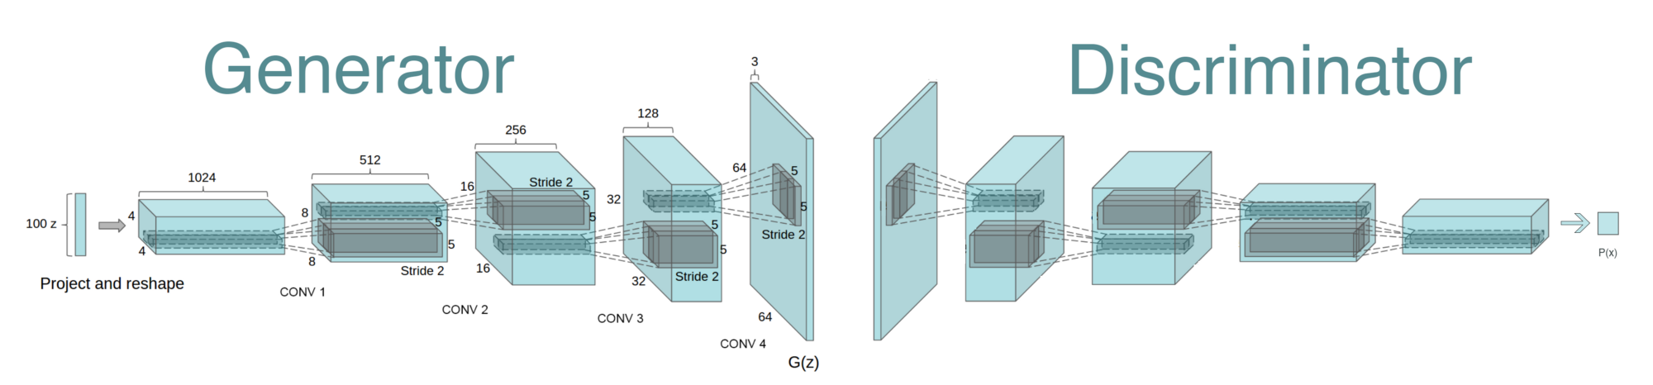
Generative Adversarial Network (GAN)
Reshape,
FC, sigmoid
FC, BN, ReLU
Reshape
Conv (kernel 5x5, stride 2)
BN, LReLU (slope 0.2)
Deconv, tanh/sigmoid
Deconv (kernel 5x5, stride 2)
BN, ReLU
https://github.com/PramodShenoy/GANerations

Slide 22
GAN on MNIST
Deconv
Tanh/Sigmoid
Conv, BN,
LReLU
Conv, BN,
LReLU
Reshape,
FC, BN,
LReLU
FC,
Sigmoid
FC, BN,
Reshape
Deconv
BN, ReLU
100
7x7x16
14x14x8
28x28x1
14x14x8
7x7x16
256
1
Generator
Discriminator

Slide 23
Issues: Convergence
As the generator improves with training, the discriminator performance gets worse
Discriminator can’t differentiate between real and fake.
If the generator succeeds perfectly, then the discriminator has a 50% accuracy.
Starts random guess (Less meaningful)
Warning: The generator may start to train on random feedback, and its own quality may reduce.

Slide 24
Problems
Imbalance
One network may dominate the other
e.g. discriminator may always tells the fake and real data and generator may not be able to fool the generator
Local Convergence
We may stuck at a local minima and not the global error
The discriminator feedback gets less meaningful over time.
The generator starts to train on junk feedback, and its own quality may collapse.

Slide 25
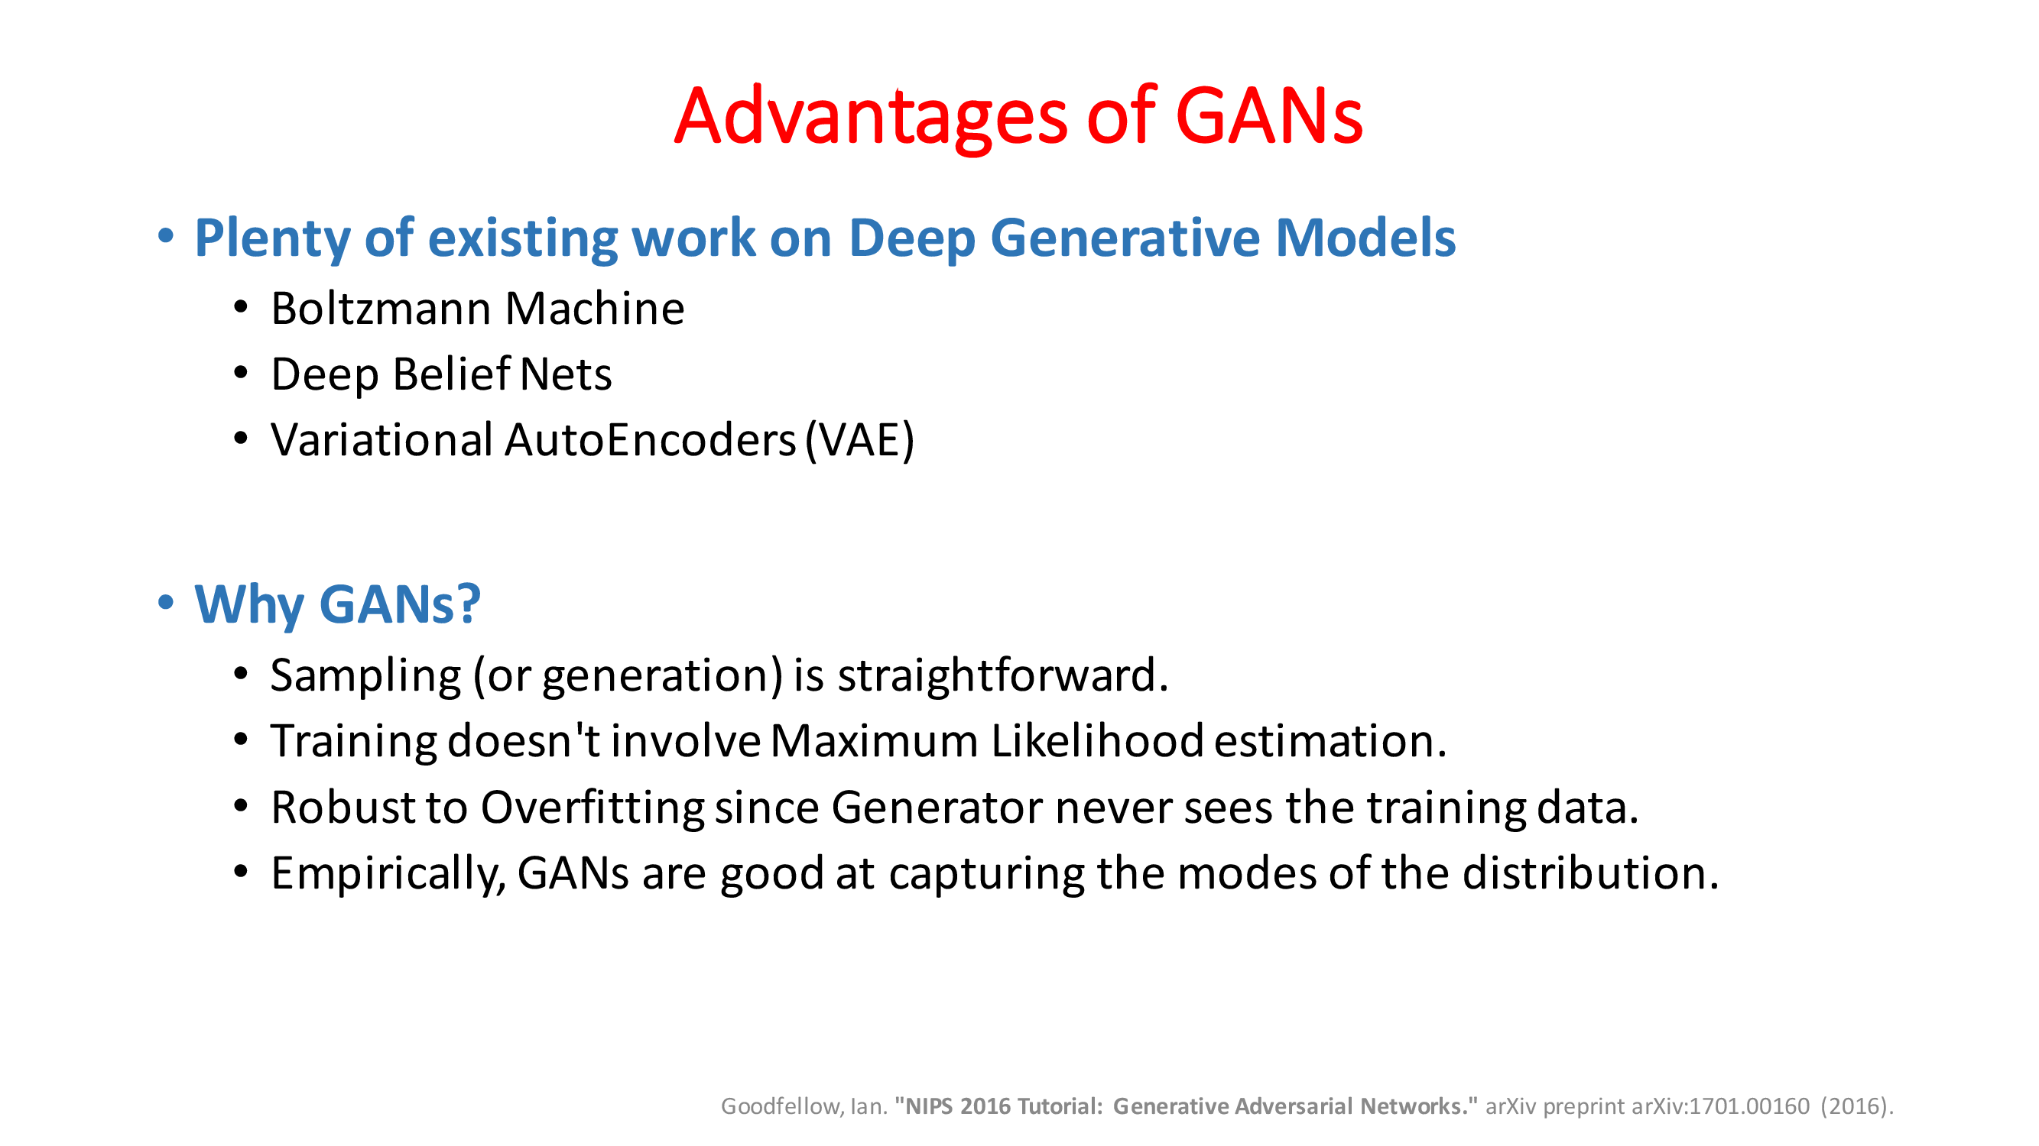

Slide 26
Thank You ☺

